Slide 1
Final-project
Chitra Karki
Introduction to Data Mining
Instructor: Dr. Pokojovi
Prediction of carbon emission rate by the vegetations in Jornada
Desert.

Slide 2
Introduction:
Data set: carbon exchange of vegetation in Jornada Desert, New Mexico
Dimension : before cleaning 116 by 70
Features :
[1] "carter1" "carter2" "chl1a" "chl1b" "chl2a"
[6] "chl2b" "cri1" "cri2" "curvature" "datt1"
[11] "gitelson1" "gitelson2" "gitelson3" "gitelson4" "gitelson5"
[16] "green1" "mndvi" "msr" "nd1" "nd2"
[21] "nd3" "ndswi_lin" "ndswi.log" "ndvi1" "ndvi2"
[26] "ndvi3" "ndvi4" "osavi" "phyt1" "phyt2"
[31] "phyt3" "phyt4" "phyt5" "phyt6" "pri1"
[36] "pri2" "pri3" "pri" "psri" "rffr1"
[41] "rffr2" "rfgreen" "rfred" "ri" "rphyto"
[46] "sipi" "sr01" "sr02" "sr03" "sr04"
[51] "sr05" "sr06" "sr07" "sr08" "sr09"
[56] "sr10" "sr11" "sr12" "sr13" "sr14"
[61] "sr15" "sr16" "sr17" "sr18" "vog1"
[66] "vog2" "vog3" "wbi" "GCC" "C02ex“
CO2ex is the response variable.
.

Slide 3
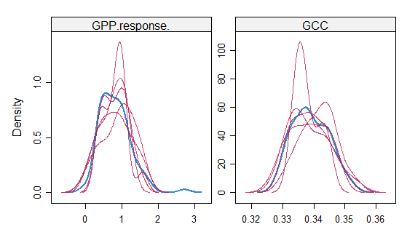
Method:
Data exploration:
Data frame contains 116 rows and 70 columns . 5 rows removed because they contain >50 % missing values
remaining missing values were imputed using program mice with method CART
all the features are of integer type
Questions to address :
predict the amount of carbon exchange between vegetation and environment,
find the important features which are important to explain the target variable.
obtain the best model for the prediction purpose,
quality of the model will be checked by MSE
Program Used : R-studio
Fig 1: Imputation of missing values using mice package with method CART. The features GPP.response and GCC were imputated in 5 iterations. Red represent imputated iterations and blue is the distribution of non-missing values of respective features.

Slide 4
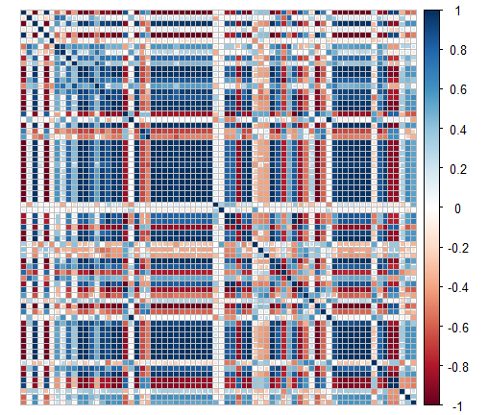
Correlation:
Features are correlated to each other i.e., collinearity exits.
Most of the features are correlated with response
variable.
Fig 2: Correlation plot

Slide 5
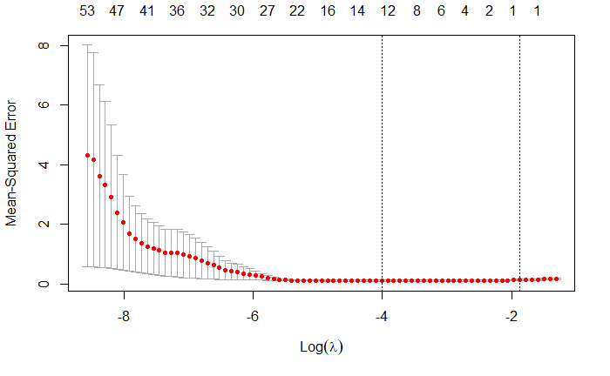
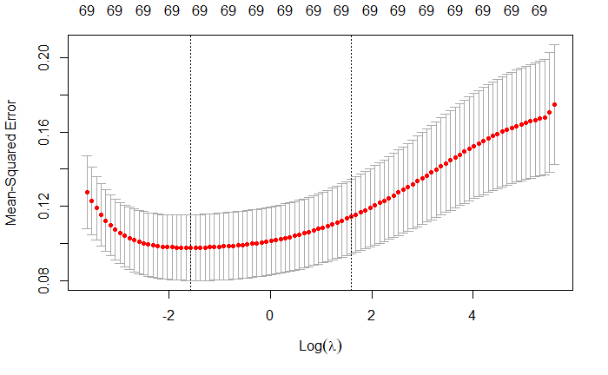
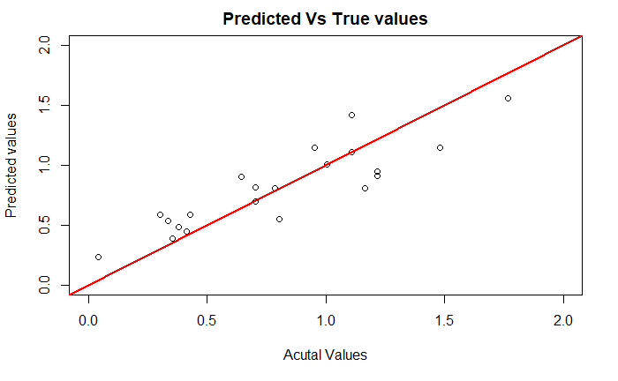
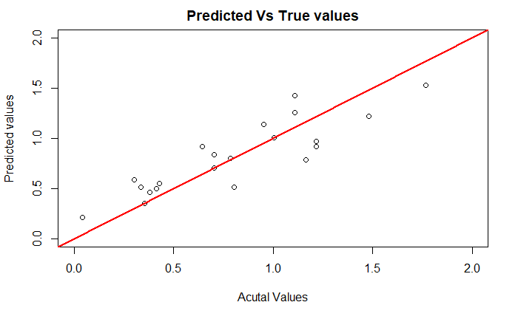
Model Fitting:
Data set was splited in training and test sets with ratio 4:1.
Model 1: Lasso and Ridge
a
b
c
d
Fig 3: Comparison Lasso vs Ridge. a and b are tunning of lambda for lasso and Ridge regression using 10-fold CV. C
And d are predicted vs actual values of lasso and Ridge, respectively.

Slide 6
Variables whose lambda are not equal to zero in lasso regression
[1] "chl1a" "curvature" "gitelson4" "pri1" "rffr1" "rfred" "sr09"
[8] "sr12" "sr17" "wbi" "GCC"
In Rigde non of the variables have lambda exactly equal to zero
The Mean squared error on test set of Lasso and Ridge are 0.04404099 and 0.04432362, respectively.
Similarly, R-squared are 0.7618603 and 0.760332, respectively
Their performance is close to each other.

Slide 7
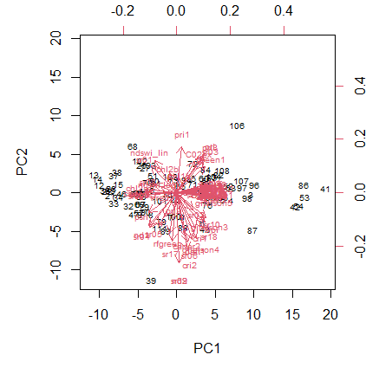
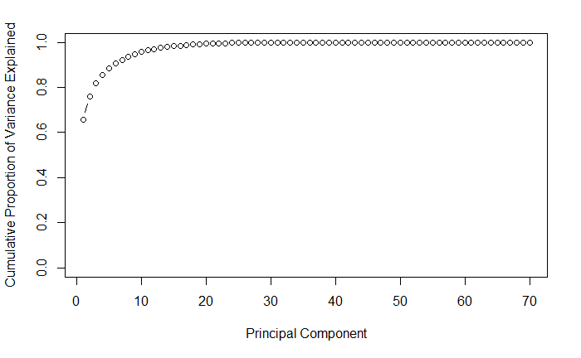
Model 2: Principal Component analysis and Regression
a
b
Fig 4: Principal component analysis. (a) pc1 and pc2 explain 66 and 10 percent variance. (b) plot of cumulative portion of each principal components. First six components explained 90 % variance.

Slide 8
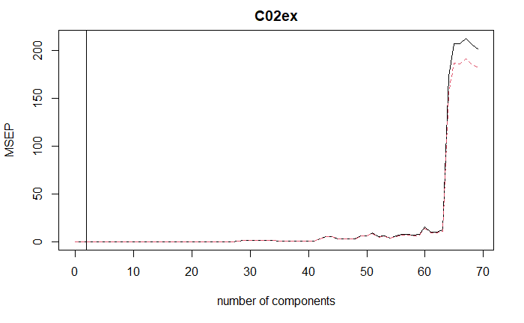
First 6 principal components explained 90 % of the variance. 2 components have minimum CV error
so we will be used it for the prediction and mse calculation in the final model of PCA as they produce minimum MSE form CV.
MSE of the final model with 2 component is 0.07712113
Minimum at 2
Fig 5: Cross validation for PCR . Here MSE is used for error calculation

Slide 9
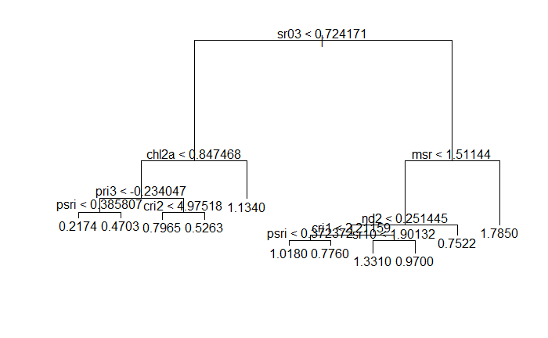
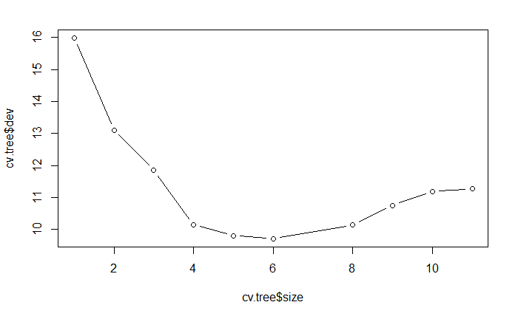
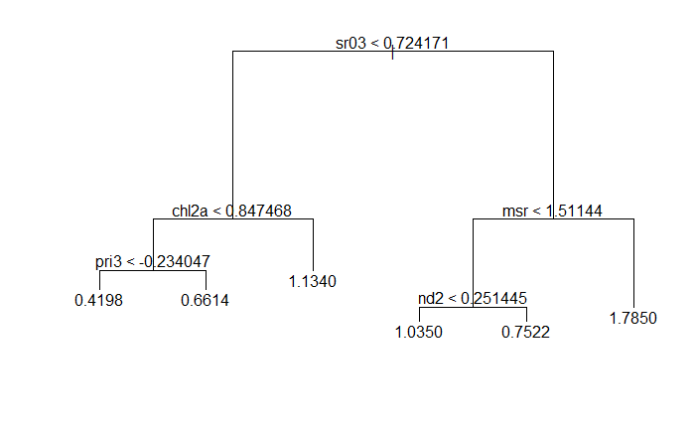
Model 3: Regression Tree
a
b
c
The MSE based of purned tree is 0.0715114
The data is scaled so for the interpretation the values of on the leaves can be unscaled.
Fig 6: Regression Tree. (a) Full Tree. (b) cv for size of the tree. (c) purned tree

Slide 10
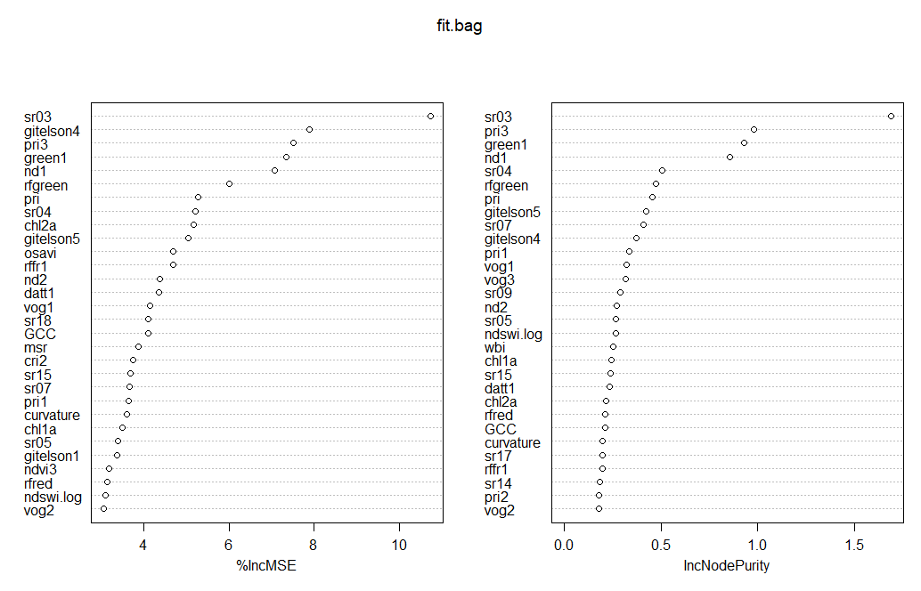
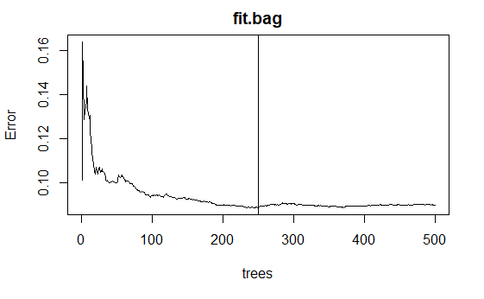
Model 4: Random Forest
Bagging
a
b
Fig 7: Bagging, (a) cv for number of trees . (b) variable importance
250 trees produced minimum error
MSE = 0.05355638 based on 250 trees

Slide 11
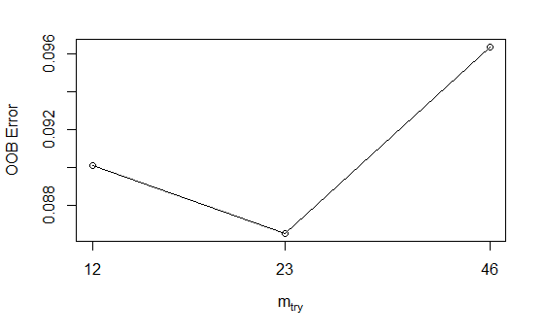
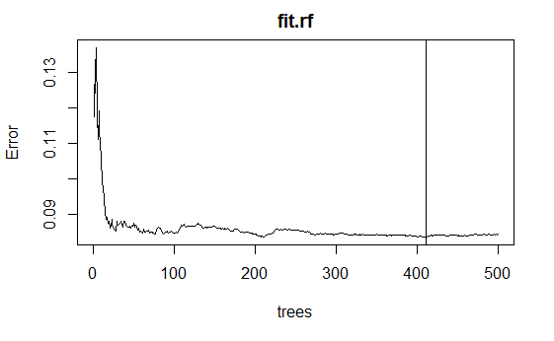
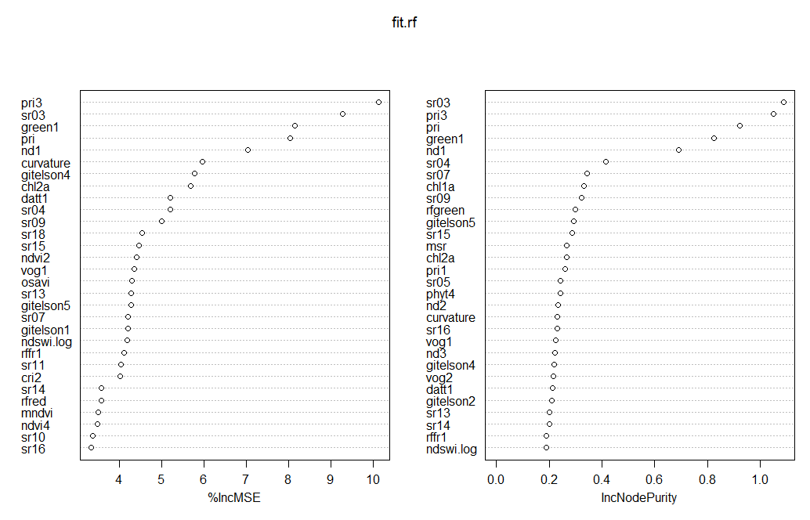
2. Random Forest
a
b
c
Fig 8: Random Forest. (a) tunning for mtry. (b) tunning for ntree. (c) variable importance.
Mtry 23 gave the minimum oob error and 411 trees gave least error for CV
MSE = 0.05867006

Slide 12
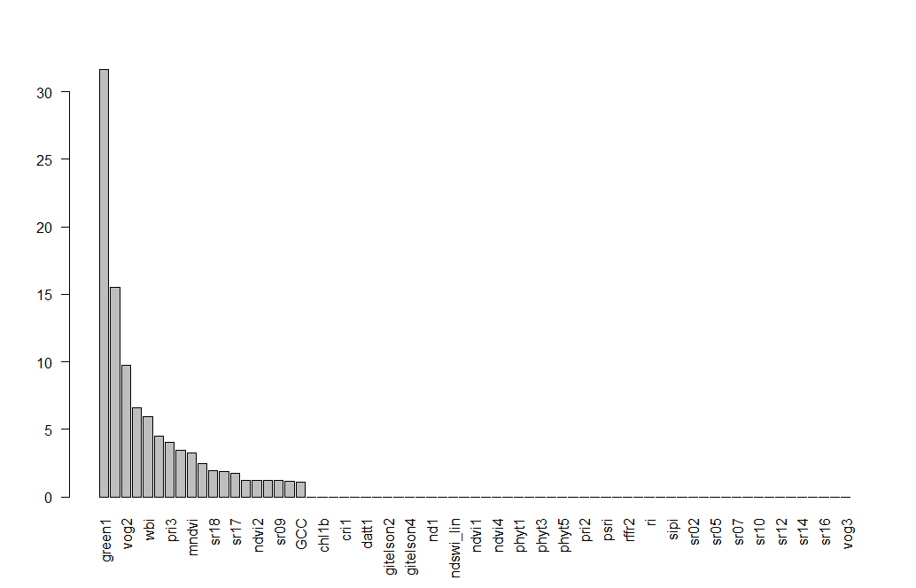
Model 5: Boosting
Fig 9: Variable importance form boosting.
Optimized lambda is 0.80 form cv.
Mse = 0.07871491

Slide 13
Conclusion
model
MSE
Lasso Regression | 0.7618603
Ridge Regression | 0.760332
Principal Component Regression | 0.07712113
Regression Tree | 0.0715114
Bagging | 0.05355638
Random Forest | 0.05867006
Boosting | 0.07871491
Various models were performed and their corresponding MSE are reported in table above.
MSE are for test set.
Different parameters of the models were tunned.
Different models predicted different list of variable importance. We can determine the cutoff for them
with further tests which is the scope of the future work.

Slide 14
THANK YOU

